Slide 1
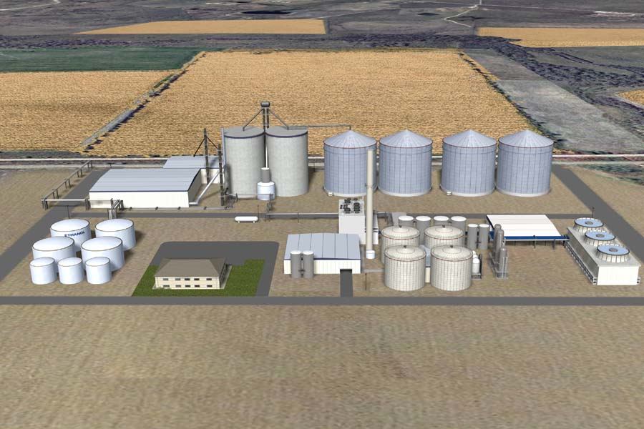
Ethanol
YASH BHARGAVA(2013A1PS523G)
TANMAY SINGHAL(2013A1PS578G)
ROSHAN M. REGY(2013A1PS646G)
GOURAV GUPTA(2013A1PS718G)

Slide 2
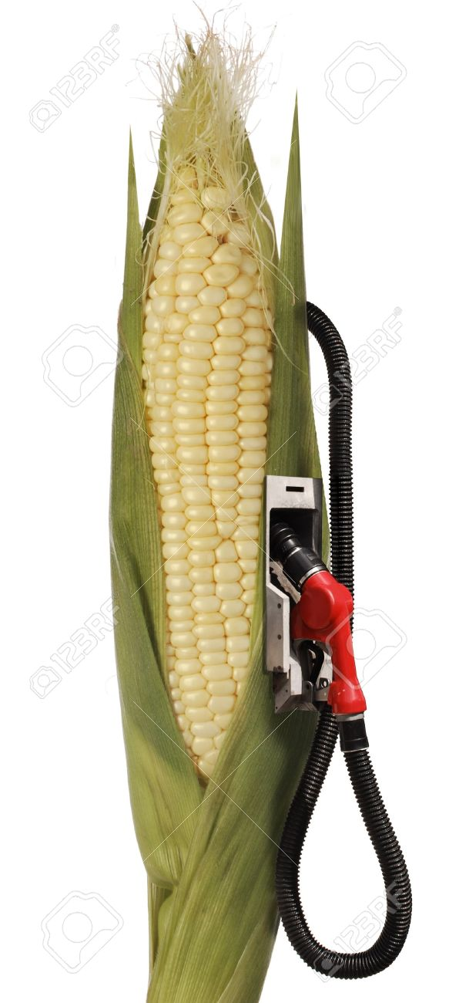
Introduction
Uses
Biofuels
Manufacture of medicines, drugs
Liquor
Disinfectants, sanitizers
Essence and flavoring agents
Paints and varnishes
Sources of production
Sugarcane (molasses)
Corn grain
Sugar beet
Lignocellulose

Slide 3
Plant Production Processes
Raw material - molasses (sugarcane)
Sugar content is transformed into alcohol by yeast
Uses basic fermentation techniques
Ethanol produced used as renewable fuel
Mainly used process in brazil
Raw material - corn(grain) starch
Starch in crushed corn meal converted to alcohol using yeast
Mainly used process in USA
Notes:
Source: sugarcane.org

Slide 4
Corn Based Ethanol Production
Most used process in U.S.
In 2005 more than 13% of u.S. Corn used for ethanol production
Reduces dependence on foreign oil imports
Cleaner for environment
Develops rural economy and agricultural production
Corn starch broken down to simple sugars for ethanol production using yeast
354 gallons of fuel grade ethanol per acre of corn

Slide 5
Sugarcane based Ethanol production
Most used process in brazil and india
Helps achieve greater energy security
Brazil replaced 42% of gasoline requirement with ethanol
Reduced emissions of carbon dioxide by 300 million tons
An acre of sugarcane gives 662 gallons of ethanol
Increasing popularity increased agricultural output and rural development
Notes:
http://grist.org/article/biofuel-some-numbers/

Slide 6
Sugarcane Based Production Process
Reactions involved
C₁₂H₂₂O₁₁ + H₂O → 2C₆H₁₂O₆
C₆H₁₂O₆ → 2C₂H₅OH + 2CO₂
Catalyst for fermentation reaction - invertase
Catalyst for ethanol conversion - zymase

Slide 7
Sugarcane Based Production Process
Fermentation
Sugar from ground molasses diluted with water
Sulfuric acid added to prevent bacterial contamination
Yeast added to feed before fermenter, provides invertase and zymase
Sugar hydrolysed to fructose using invertase
Glucose and fructose converted to ethanol and carbon dioxide using zymase
Carbon dioxide washing
Gaseous stream sent to CO2 washer
Ethanol absorbed in water
Gaseous stream vented into atmosphere
Liquid stream recycled to fermenter

Slide 8
Sugarcane Based Production Process
Ethanol distillation
Liquid stream from fermenter contains sucrose, glucose, fructose and sulfuric acid
Stream sent to concentration tower
Superheated steam at atmospheric pressure used as stripping gas
Bottom stream contains water with sucrose, sulfuric acid
Top gas stream sent to rectifier
Bottom stream from rectifier contains final product

Slide 9
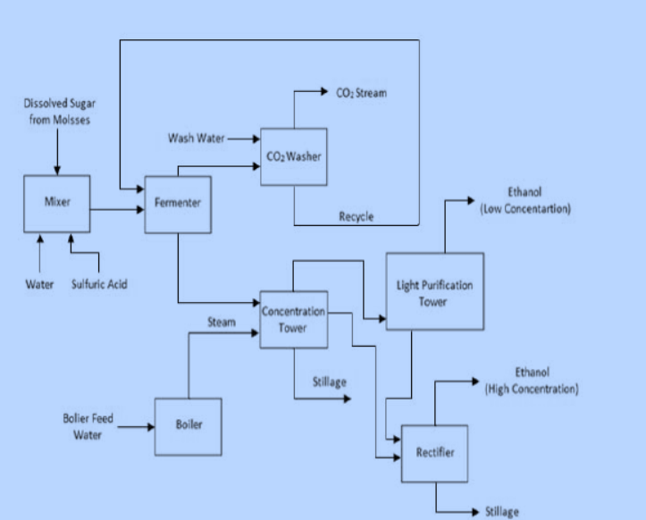
Sugarcane based production Flowsheet

Slide 10
Corn Based Production Process
Two industrial methods
Wet milling
Grain soaked in water for easier fractionation of components
Fractionation separates starch and fibers for processing
Dry grinding
Milling
Liquefaction
Saccharification
Fermentation
Distillation and recovery

Slide 11
Dry Grinding
Milling
Corn passed through hammer mills to prepare flour
Flour slurried with water and heat-stable enzyme(amylase) added
Liquefaction
Slurry is cooked at 100deg C
Heat and mechanical shear used to break starch granules
Cooked corn mash allowed to cool to 80-90 deg C
Saccharification
Corn mash cooled to 30 deg C
Glucoamylase added to complete breakdown to simple sugars

Slide 12
Dry Grinding
Fermentation
Yeast is added to corn mash to begin conversion
Fermentation usually done in batches
Up stream and down stream processes usually done continuously
Carbon dioxide produced usually vent to the atmosphere
Distillation and recovery
Liquid slurry sent to distillation/recitfication systems
Molecular sieves used to separate water from ethanol/water vapor mixture
Residual water and solids - stillage centrifuged and recycled to the fermenter

Slide 13
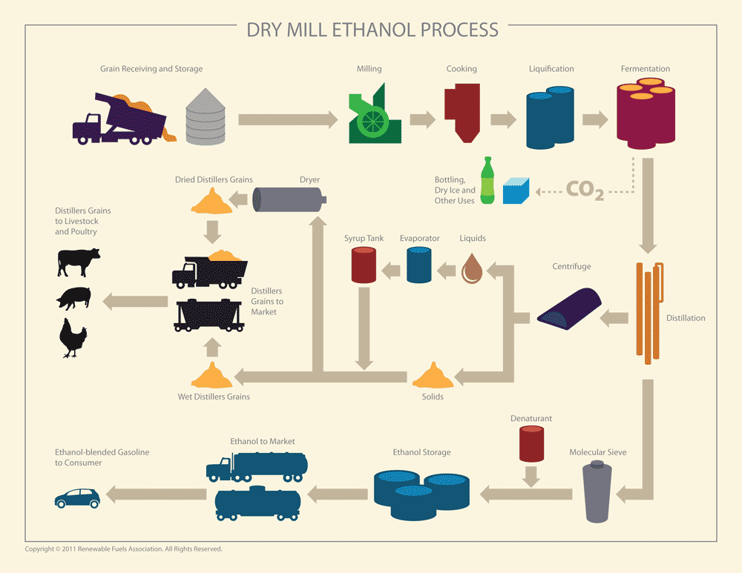
Corn Based ethanol production flowsheet

Slide 14
ETHANOL FROM MOLASSES
Flow Sheet Components
Presented By-
Yash Bhargava

Slide 15
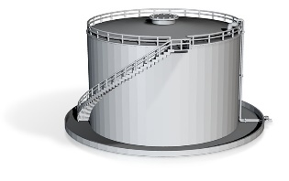

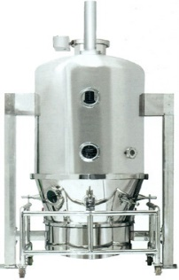
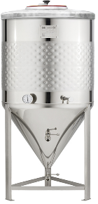
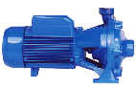


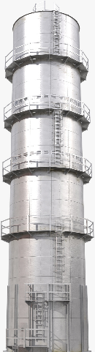
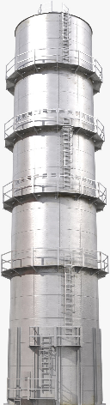
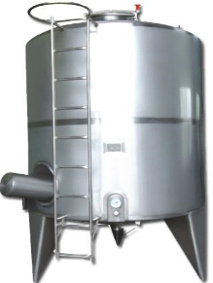

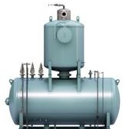
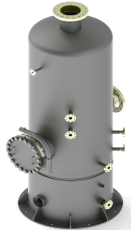

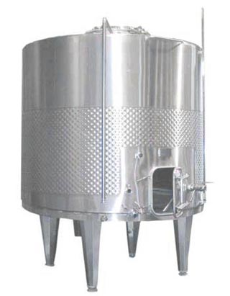
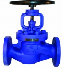
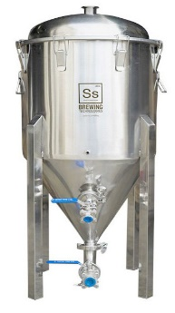
Molasses
Sterlizer
Yeast
Cultivation
Tank
Molasses
Storage
Beer
Still
Aldehyde
Still
Rectifying
Column
Diluter
Scrubber
Fermentation Tank
Storage Tank
Azeotropic
Distillation
Mix Tank
Ethanol Manufacture from Molasses

Slide 16
Nutrients
CO₂
Yeast Cultivation Tank
Molasses Sterllizer
Steam
`
50-60% alcohol+ aldehyde
Aldehyde
`
95% Ethanol
`
CO₂
Molasses Storage
Yeast Storage
Denaturant
Fusel oil
Diluter
H₂O
Mix
Denatured
Scrubber
Beer Still
Aldehyde Still
Rectifying Column
Storage
Alcohol
Tank
Tank
Decanter
`
Water Scrub with
1-2% alcohol
Fermentation Tank
Ternary
Azeotropic
Distillation
100% Ethanol
`
Benzene
Water
H₂O
H₂O
Slops

Slide 17
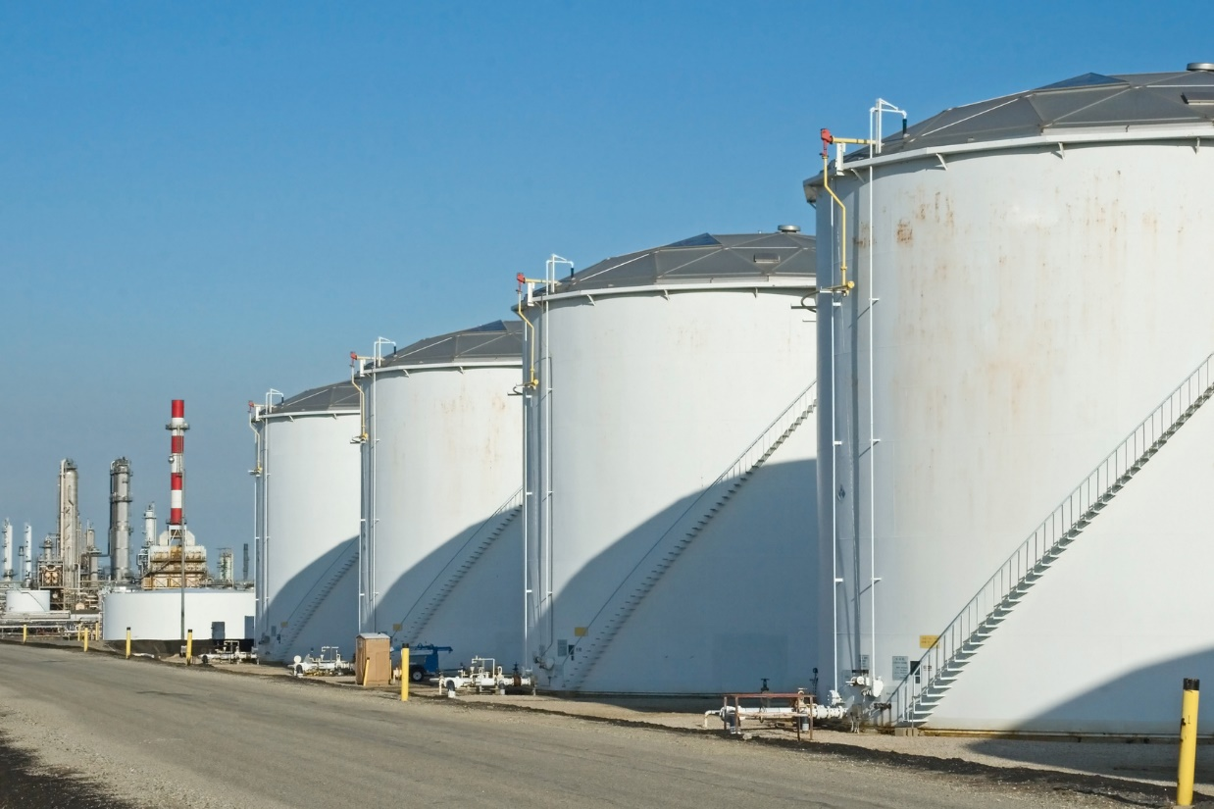
Molasses Storage Tank -
Molasses is a by product from the sugar industry. Contains sucrose, fructose and glucose. Is a heavy viscous fluid. Stored in a tank to maintain a uniform flow to the further equipment's.
Diluter –
Convert the heavy viscous fluid to a smooth flowing liquid of conc. Around 10-15% wt/vol.

Slide 18
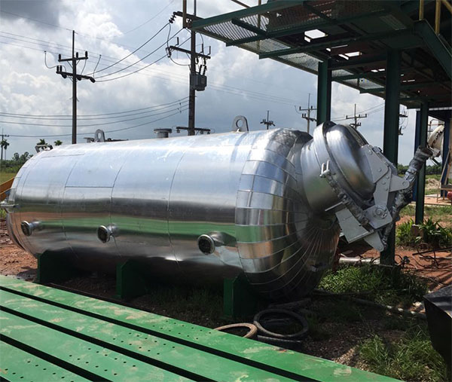
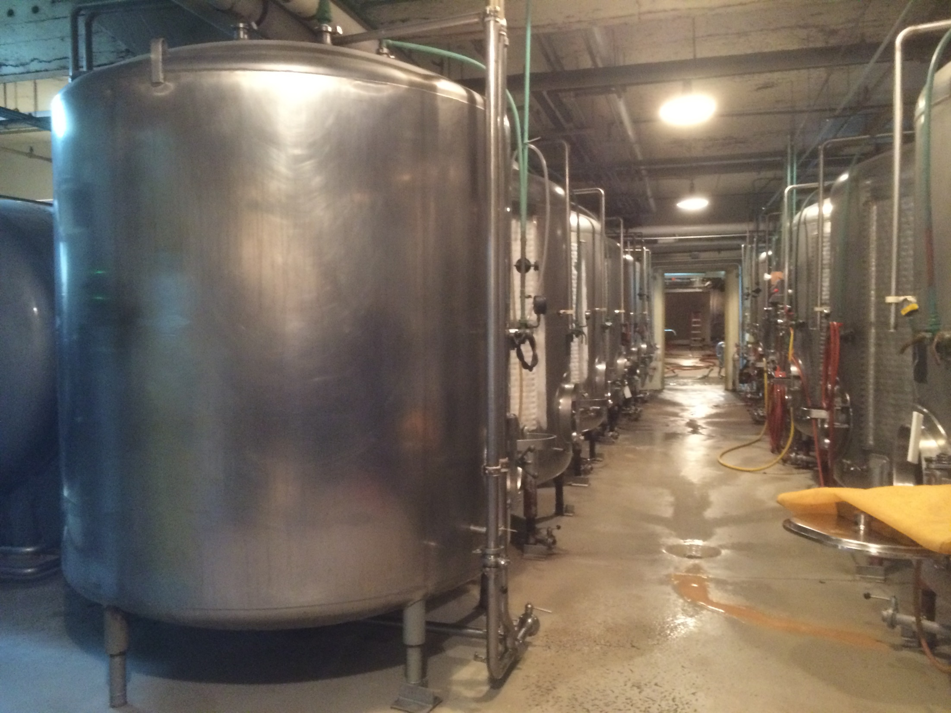
3.Sterlization tank –
Done to remove all the other bacteria’s and viruses present in the feed. High Pressure is applied and then it is cooled down
4.Yeast cultivation Tank –
Over here the required nutrients are added to help in the formation of yeast in the feed liquid. Extra oxygen content is provided in helping the yeast to develop.

Slide 19
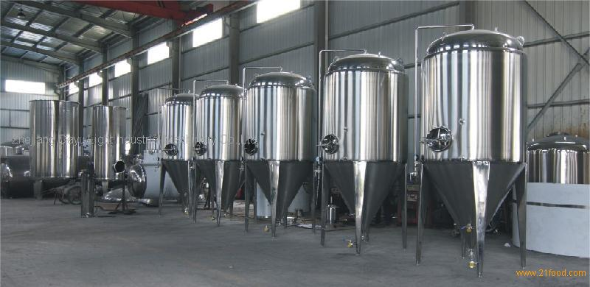
5.Yeast storage tank –
acidic environment is created to help the yeast to survive. pH is adjusted to around 4.8-5.
6.Fermentation tank – Chemical changes brought about the action of the enzymes present in the yeast. Enzymes being invertase and zymase.
Invertase
C₁₂H₂₂O₁₁ + H₂O 2C₆H₁₂O₆
sugar
Zymase
C₆H₁₂O₆ 2C₂H₅OH + 2CO₂
glucose

Slide 20
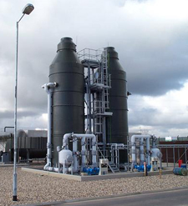
Since yeast live at lower temperature and the reaction is exothermic heat exchanger are required to maintain the temp around 20-30ºC. pH changes due to product formation and hence HCl or sulphuric acid is added to maintain around same earlier range of 4.8-5. Whole process takes around 2-3 days in the fermentation tank where the output is 8-10% alcohol content. CO₂ is released as the by product.
7.Scrubber –
The CO₂ released contains ethanol vapor and can be recovered using scrubbing with water. This water is then fed to the diluter helping in the dilution step.

Slide 21
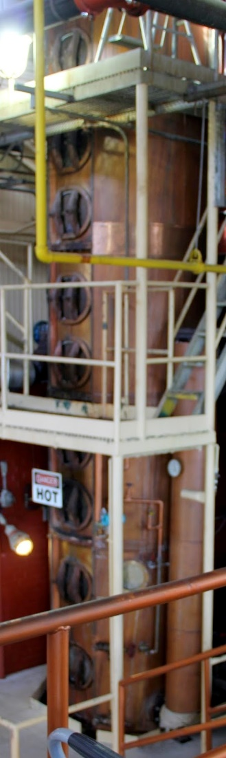
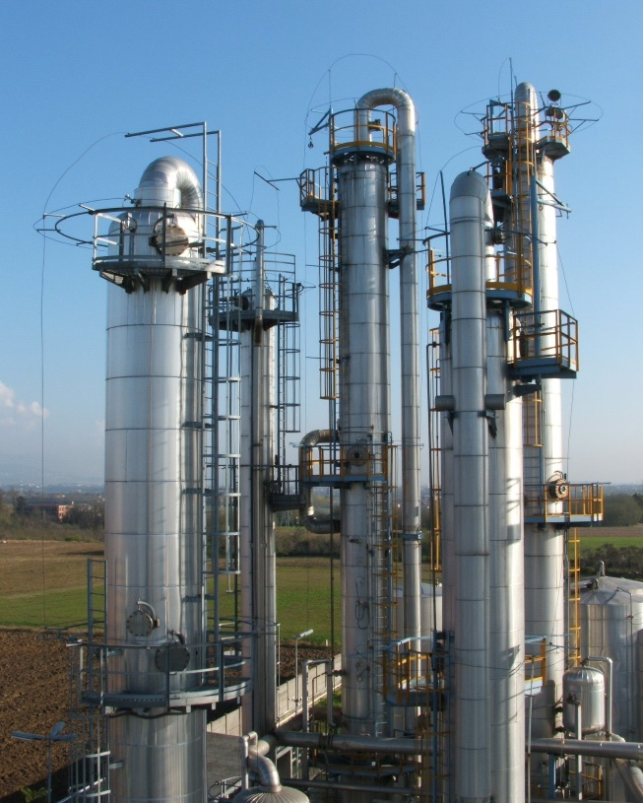
8.Beer Still –
Alcohol content is increased in the column and aldehydes are also obtained. The bottom products are slops which are then further concentrated by evaporation and used as cattle feed or are discharged as wastes. Consists of proteins sugar and vitamins.
9.Aldehyde Still –
The top product from the previous section fed to the extractive distillation column where aldehyde is removed as the top product operating at around 0.6-0.7 MPa.

Slide 22
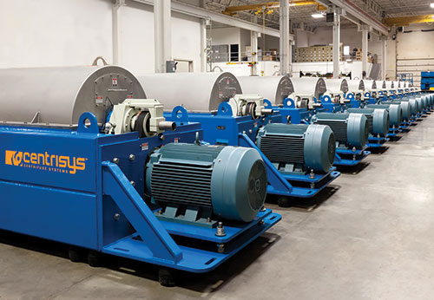
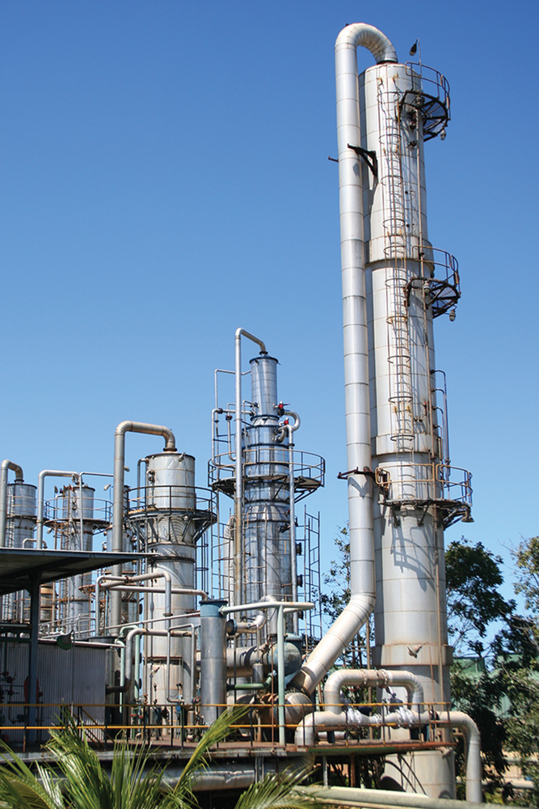
10.Decanter –
Higher molecular weight alcohol are recovered in the form of fusel oil which can be converted to amyl alcohols by fractional
distillation or can be sold directly. Since higher alcohols are more volatile than ethanol in solution of water, hence it is necessary to separate them.
11.Rectifying Column –
ethanol water mixtures are rectified to enrich the strength of alcohol, but an azeotropic mixture of 95% ethanol and water is obtained as the final product. Side streams recycled back to the decanter.

Slide 23
12.Storage Tank –
This is where majority of the final product is stored. It results in 3 different streams:
Product for direct sale – 95% pure ethanol.
Product for industrial use – denaturants are added to make it unfit for consumption.
To obtain more purity ethanol – sent to the anhydrous still (ternary distillation).
13.Ternary Azeotropic Distillation –
Mixture of water, ethanol and benzene. Ethanol can now be separated from water as benzene and water form a stronger azeotrope. Motor fuel grade (100%) ethanol obtained.

Slide 24
ETHANOL
FROM
CORN GRAIN
Presented By-
Tanmay Singhal

Slide 25
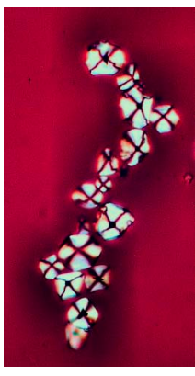
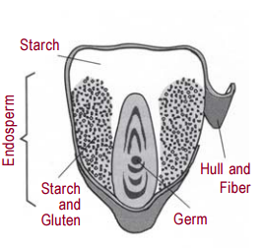
CORN GRAINS
Corn starch under polarized light
A kernel of Corn
(Embryo)
(Protein)
Ref:
http://corn.org/wp-content/uploads/2009/12/Starch2006.pdf
Ref:
http://corn.org/wp-content/uploads/2009/12/Starch2006.pdf
Corn Composition
Starch | 70-72%
Proteins | 9%
Oils | 4%
Fiber | 2-8%
Water | 15%

Slide 26
Ethanol Flow Sheet
Method-2
http://www.ethanolrfa.org/how-ethanol-is-made/

Slide 27
Grain Receiving and Storage
Corn is brought into the facility and held in storage silos prior to cleaning, where broken corn, foreign objects, and finer materials are removed using a blower and screens.
These silos are sized to hold sufficient corn for 12 days of plant operation.
The cleaned corn is ground in a hammer mill
Ref:
https://www.osha.gov/dts/osta/otm/otm_iv/otm_iv_5.html
Cleaning
The corn kernels must be cleaned prior to processing.
Multiple screeners or scalpers arranged to remove oversized materials .
Ref:
https://www.osha.gov/dts/osta/otm/otm_iv/otm_iv_5.html

Slide 28
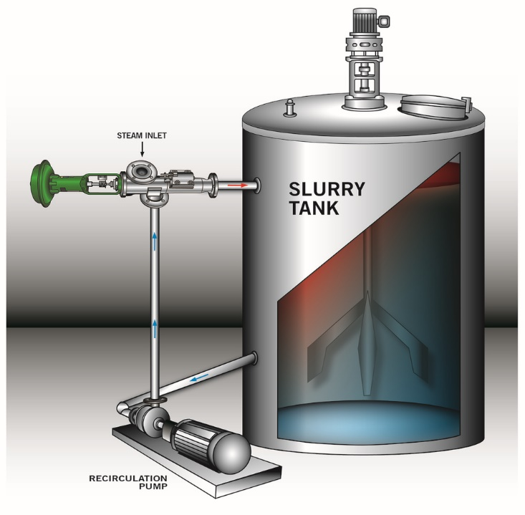
Milling
Coarse flour is converted to fine mesh screen in hammer mill which uses impact force to reduce the size.
This is done to increase the surface area of the starch making it ready to react with water and enzymes.
Slurry Tank
Ref:
https://www.osha.gov/dts/osta/otm/otm_iv/otm_iv_5.html
Corn flour is mixed with hot water and alpha-amylase(1/3) with little ammonia which helps in breaking the bonds of starch and convert it into glucose.
Temp: 85 ⁰C
PH: 5.6 – 6
Solid = 32%
Ref:
http://www.hydro-thermal.com/2014/07/how-to-increase-ethanol-yield-by-900000-per-year/

Slide 29
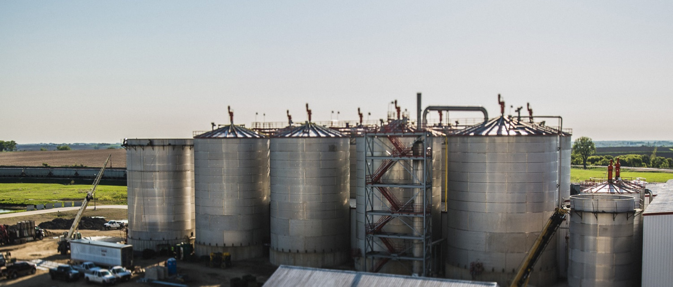
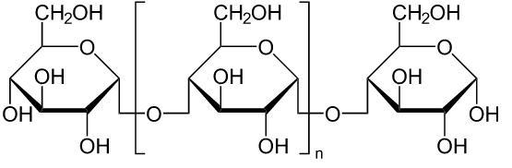
Jet Cooking and Liquefaction
The slurry is then heated above 104 ⁰ C using direct steam.
Residence time is about 30 mins.
Rest amylase(2/3) is added to further breakdown of long starch granules to small ones called dextrin.
Dextrin
Ref:
https://www.osha.gov/dts/osta/otm/otm_iv/otm_iv_5.html
Ref:
http://www.parchem.com/news-articles/Parchem-Premier-Supplier-of-High-Quality-Dextrins-N000146.aspx

Slide 30
Fermentation
This step takes the longest time i.e. 40 to 50 hours.
CO2 is released at this stage.
Another enzyme glucoamylase converts dextrin to glucose by complete breakdown. (Saccharification )
Finally yeast is added which converts glucose into E85 and CO2.
Yeast best works for:
Slightly acidic medium
Less salty surrounding
Moist environment
Temp 60-80⁰C
Ref:
https://www.osha.gov/dts/osta/otm/otm_iv/otm_iv_5.html

Slide 31
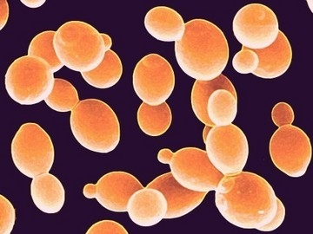
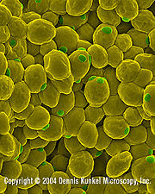
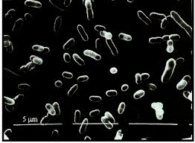
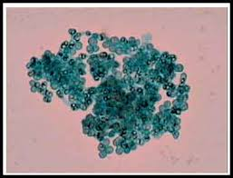
Microbes Used for Ethanol Preparation
Yeast- can withstand extreme environmental stress including high ethanol concentration and other contaminants.
Saccharomyces cerevisiae (ale yeast)
Saccharomyces pastorianus
Zymomonas mobilis
Schizosaccharomyces
Zymomonas mobilis
Ref:
https://microbewiki.kenyon.edu/index.php/Saccharomyces_cerevisiae_NEU2011

Slide 32
Distillation
It is carried out in 3 steps
Degassing- in which dissolved gases and CO2 is removed.
Separation of ethanol/water mix from non-converted solid mix called stillage which is later send to centrifuge for separation.
Rectification column where ethanol is separated from water but partially after which the product is send to molecular sieve for further conversion to pure ethanol.
Ref:
https://www.osha.gov/dts/osta/otm/otm_iv/otm_iv_5.html

Slide 33
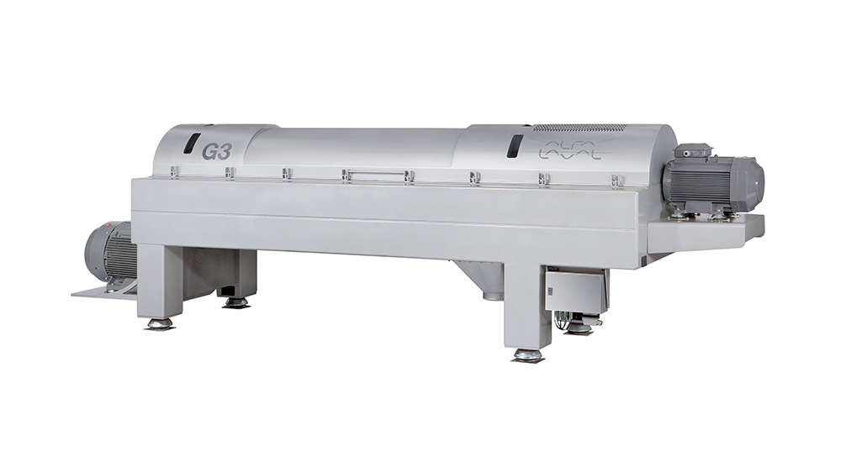
Molecular Sieve
Since the mix of water and ethanol form a azeotrope i.e. Constant boiling mixture, this method depending on the pore size separate the smaller molecules of water from ethanol.
About 5% of water molecules are removed.
Temp: 138⁰C
Pressure: 6 psig
Size : 2 nm (20 Å)
Ref:
https://www.osha.gov/dts/osta/otm/otm_iv/otm_iv_5.html
Centrifuge
About 13-17% of solid material from ethanol don’t convert into ethanol and are called stillage.
These are passed through stillage which separates them as thin stillage and wet cake(35% solids).
Thin stillage are send to evaporator
Ref:
http://www.ethanolproducer.com/articles/9571/tuning-up-the-decanter-centrifuge

Slide 34
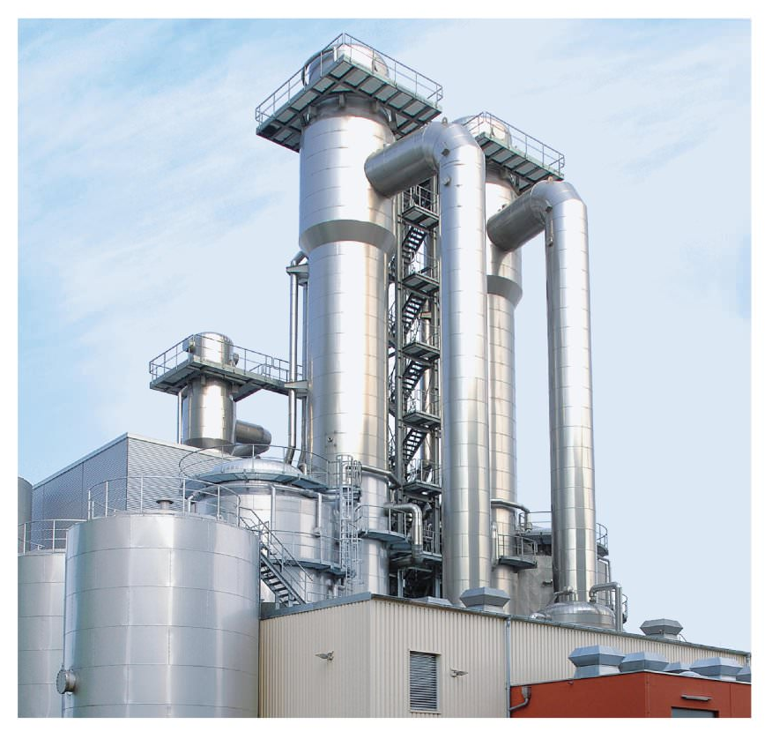
Evaporator
Water from thin stillage (4-5% solids) is evaporated and recycled back to liquefaction process.
The remaining liquid (28-30% solid) called syrup is mixed with wet cake and dried at 315-650⁰C.
This mix is then used to make protein ,oil, DDG (Dried Distilled Grains).
Ref:
https://www.osha.gov/dts/osta/otm/otm_iv/otm_iv_5.html
Denaturation
5% of gasoline is mixed as an additive to make it bad in taste and smell to reduce its recreational purpose and exempt ethanol from beverage alcohol taxes.

Slide 35
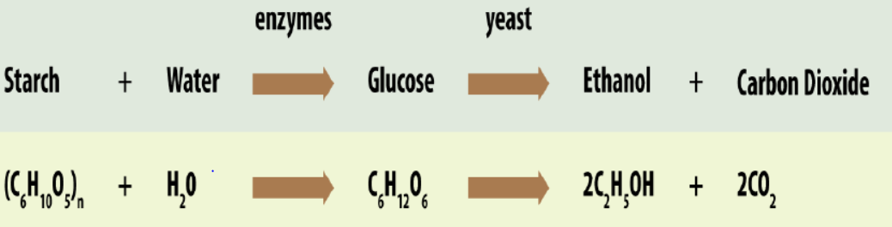
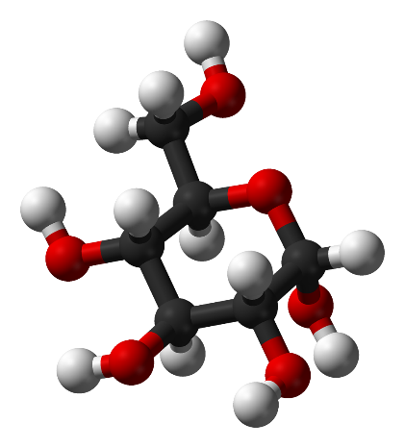
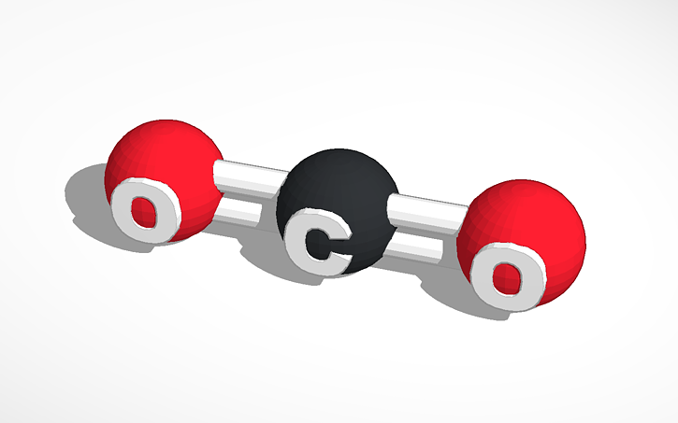
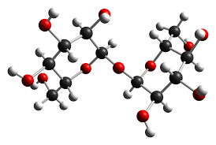
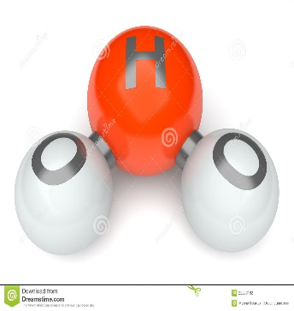
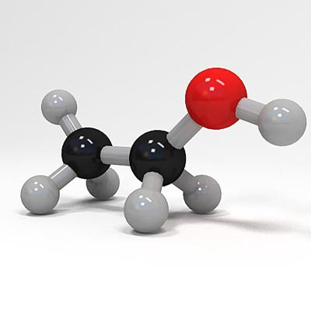
Reactions Involved

Slide 36
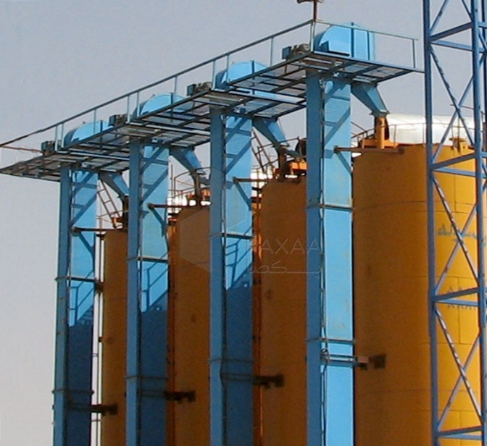
Equipment's Involved In Process
Bucket Elevator and Silos
Hanson silo company 1916 (US)
Taian shelley engineering co., Ltd. (China)
India
Aum industrial seals limited.(Gujrat)
Ref: http://www.paxaa.com/c/179/Bucket-Elevators

Slide 37
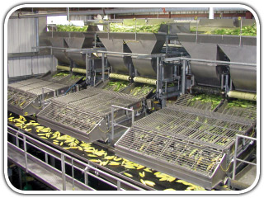
Corn Husker
Henan hengmu machinery co., Ltd. (China)
India
SHREEJI EXPELLER INDUSTRIES (Punjab)
Ref:
http://www.akdco.net/pages/main/history.php

Slide 38
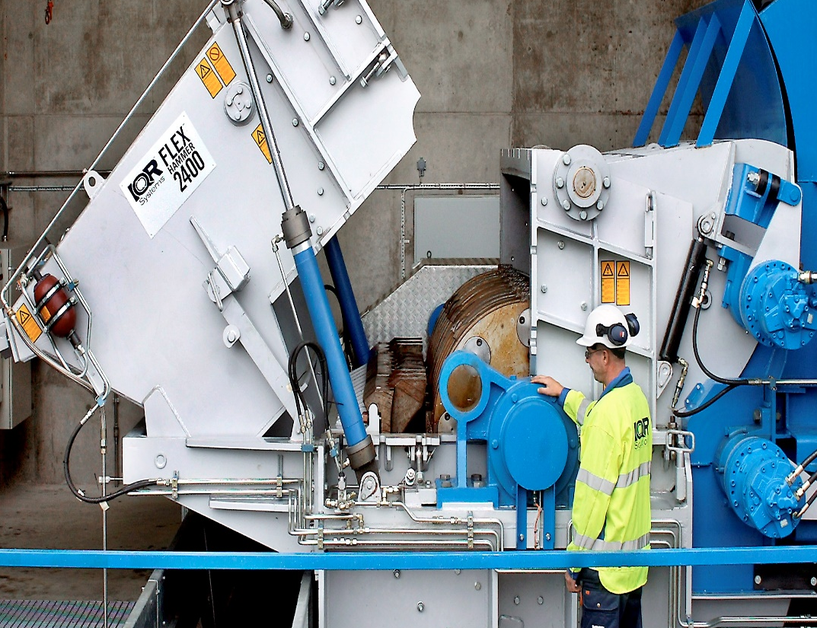
Hammer Mill
Quadro alloys and trading enterprises (South Africa)
Zhengzhou mega industry co., Ltd. (China)
India
GOYUM SCREW PRESS (Punjab)
Ref:
http://www.wikiwand.com/en/Hammermill

Slide 39
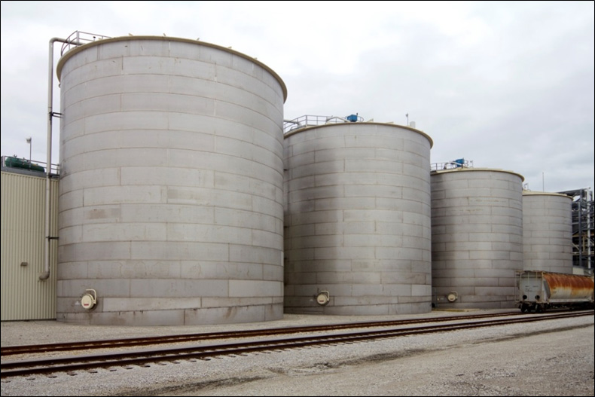
Ethanol Fermentation Tank
Shanghai kaiquan machine valve co. Ltd. (China)
Jinan zhuoda machinery equipment co. Ltd. (China)
Ref:
https://www.osha.gov/dts/osta/otm/otm_iv/otm_iv_5.html

Slide 40
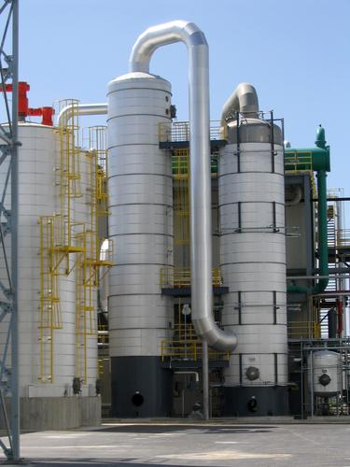
Ethanol Distillation Columns
Wuxi rising machinery co., Ltd. (China)
Oklu metal taahhut ticaret limited (turkey)
Ref:
http://teeic.indianaffairs.gov/er/biomass/restech/desc/ethanolplants/index.htm

Slide 41
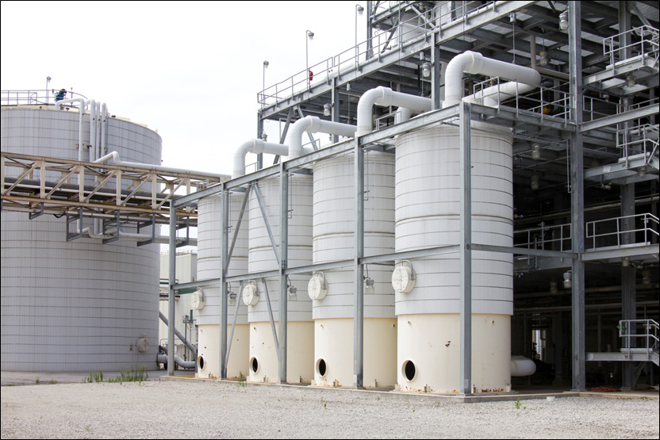
Molecular Sieve Packed Bed Tanks
Shree Renuka sugars limited (brazil)
Ref:
https://www.osha.gov/dts/osta/otm/otm_iv/otm_iv_5.html

Slide 42
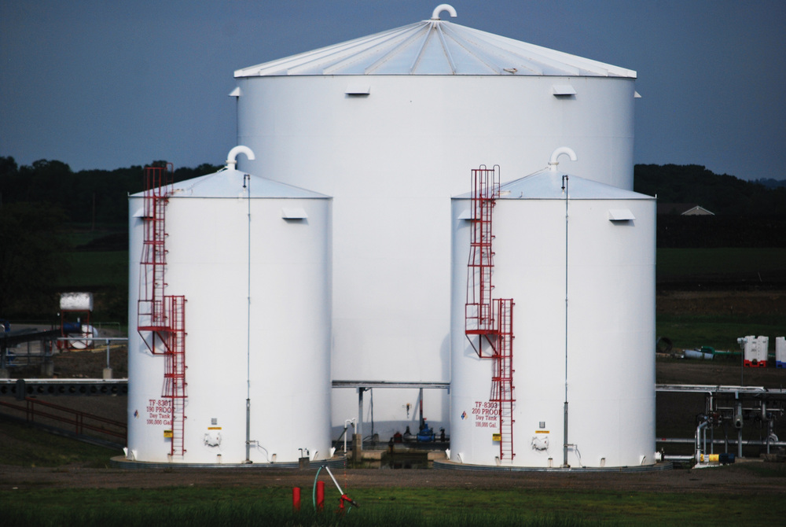
Ethanol Storage Tanks
Shenyang yongye industry co., Ltd. (China)
Steel tech S.R.L. (Italy)
India
Bharat tanks and vessels (pune)
Ref:
http://www.ethanolproducer.com/articles/9684/ethanol-tanksundefinedhave-they-been-inspected-lately

Slide 43
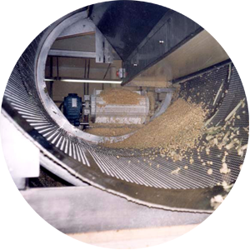




Production Steps | Primary Inputs | Primary Outputs | Operations Performed
Receipt, storage, and inspection | Shelled corn | Stored corn | Receive shelled corn by truck or rail
 |  |  | Unload corn into receiving pits
 |  |  | Transfer corn to storage bins or silos
 |  |  | Inspect corn upon receipt
 | Shelled corn from storage | Cleaned whole corn kernels | Pass corn through screeners or scalpers to remove oversized and smaller material
 |  |  | Pass corn to remove other unwanted objects
 | Cleaned whole corn kernels | Fine corn flour | Transfer whole kernels to a hammer mill, impact mill, or other milling operation
 |  |  | Crush and grind shelled corn into a fine flour
Liquefaction | Fine corn flour | “Mash” (liquid mixture of corn flour and other corn parts) | Mix fine corn flour with water in large cook or slurry tanks
 |  |  | Add chemicals to adjust the slurry’s pH
 |  |  | Add enzymes (alpha amylase) to solution to break down corn starch into dextrins
Saccharification | “Mash” | Mash with starch broken down into simple sugars | Add enzymes (glucoamylase) to mash to breakdown dextrins into glucose
Cleaning
Milling

Slide 44



Production Steps | Primary Inputs | Primary Outputs | Operations Performed
Fermentation | Mash with starch broken down into simple sugars | Mixture containing ethanol and solids from grain and yeast; and carbon dioxide | Add yeast to convert glucose in mash into ethanol and carbon dioxide
 | Mixture containing ethanol and solids from grain and yeast; and carbon dioxide | Denatured ethanol | Pump mixture into a continuous distillation system, which may contain multiple columns
 |  |  | Collect purified ethanol from the vapor portion of columns and spent solids (stillage) from the bottom
 |  |  | Purify ethanol stream in rectifying column, molecular sieve, or other production equipment
 |  |  | Add denaturant to ethanol in cases where ethanol is not used for human consumption
 |  |  | Store denatured ethanol in tanks until distribution
Co-product processing | Stillage from distillation columns | Wet distillers’ grain and/or dried distillers’ grain with solubles (DDGS) | Reduce moisture content in stillage by using centrifuges, dryers
 |  |  | Make selected co-products by mixing varying quantities of dry products with other materials
 |  |  | Load dry products into trucks, railcars, or other means of transport for distribution
Distillation
and
Dehydration

Slide 45
Now Let us see the plant processes in action
-Video

Slide 46
Future scope & issues related to ethanol production
- GOURAV GUPTA

Slide 47
Advantages of Ethanol as a fuel
Renewable resource: in comparison to gasoline, it can be renewed.
Use of by-products: carbon dioxide that can be fed to the plants which are being grown for the purpose of being fermented. This cycle has the potential to become self sustaining and reducing air pollution.
Lower emissions: when ethanol is added to the fuel, it burns in a cleaner manner and releases fewer emissions in comparison to pure gasoline.
Reduces dependence on foreign oil and greenhouse gas emissions.
Booming farming industry: more jobs are created in rural areas as ethanol is produced from domestically grown crops.
Anti freeze: in colder climates, ethanol-blend fuel will not freeze even under freezing temperatures.

Slide 48
Disadvantages
High cost of production: expensive to produce in the current market.
Monoculture: economically attractive for farmers but growing same crop every year may deprive the soil of nutrients.
Use of fertilizers: harmful effects on surrounding environment and may cause water pollution.
Shortage of food: does not cause an acute shortage of food, it will definitely put pressure on the current growth of crops and may cause rise in food prices as well.

Slide 49

Future Scope
Cellulosic biomass:
Whole range of plant fibres that could be used to produce fuel alcohol
In York, Nebraska, Abengoa bioenergy opened a research ethanol plant in 2007 that converts wheat straw into alcohol.
Many different sources of cellulose are being used in the experiments – corn stalks, leaves, cobs and husks; forestry waste like wood chips, bark and sawdust; even paper pulp.
Produce 90 percent less greenhouse gasses through its production and use.

Slide 50
Switch grass:
Another source of cellulosic ethanol.
The fast-growing, perennial prairie grass can stand up to seven feet tall, requires little water and can be grown on marginal land.
Algae:
Algae are single-celled organisms – often called pond scum – that can grow in wastewater, even saltwater.
Some species of algae make starch that can be processed into ethanol; others produce tiny droplets of oil that can be brewed into biodiesel or even jet fuel.
Theoretically, an acre of algae could churn out more than 5,000 gallons of biofuel a year.

Slide 51
Improvement In The Process
The processes requires a source of heat – usually natural gas or coal.
It may take almost as much energy to distill ethanol from corn as the ethanol is capable of producing when it's burned.
Closed loop system:
Combining ethanol plant and cattle feedlot
Methane gas from the cattle manure can be used as a heat source in the ethanol plant
The protein by-product of the ethanol plant can be used as a feed source for the cattle
Wastewater as a new source of producing microalgae using photo-bioreactors which can be used for fermentation purposes.

Slide 52
Vision 2020
Total ethanol consumption in 2010 was 1.8 billion litres of molasses derived ethanol, out of which only 50 million litres was used for blending.
India has to achieve the 20 percent blending targets set out by the national policy of biofuels, the country will need to produce 6.7 billion litres of ethanol by 2020 and 9.1 billion litres by 2030.
Production to such levels would be extremely challenging, since the country’s sugarcane yield has been stagnating at approx. 65-70 tonne/ha for the past several years.

Slide 53

Ethanol demand with blending targets (%) in India

Slide 54
Economic Issues
Economic output factors
Ethanol
Distillers grain
Carbon dioxide
Economic input factors
Grain factors
Grain price
Grain availability
Energy costs
Transportation

Slide 55
Environmental Issues
Air quality:
Air quality can also be an issue when the carbon dioxide and other odour causing emissions produced during the fermentation process are not recaptured or cleaned before being exhausted.
The source of an ethanol plant's power, as well as the type of production process, will affect the level of greenhouse gas (ghg) emissions.
Water issues:
There are two water uses in a typical ethanol plant. The first is for liquefaction of the feedstock. Water must be clean and treated so there is no microbiological contamination. The quality level depends on plant design.
The second is non contact water, primarily used for cooling. This may be recycled cooling tower, well or river water. In the latter case water is returned to a river or lake.

Slide 56
There are "zero discharge" plants in operation. Most plants that do discharge process water should not have a biological oxygen demand (BOD) value higher than domestic sewage (300 to 400). This water can/should be treated in the plant.
Energy consumption:
Dependent on the type of feedstock, the production process used, and the level of technology employed.
The net energy gain and environmental benefits of ethanol blended fuel are compromised when "dirty" fuels are used to power any of the various stages of the production process.

Slide 57

http://www.attenbabler.com/wp-content/uploads/India-Ethanol-and-Sugar-Production.png

Slide 58
References:
Simulation of ethanol production by fermentation of molasses.
-Ruhul Amin, Saquib Hossain , Sarker
Modeling the process and costs of fuel ethanol production by the corn dry-grind process.
-Jason R. Kwiatkowski , Andrew J. Mcaloon, Frank Taylor, David B. Johnston
Ethanol production: energy, economic, and environmental losses
-David Pimentel, Tad Patzek, and Gerald Cecil
PROMOTING LOW CARBON TRANSPORT IN INDIA biofuel roadmap for india
-Pallav Purohit, Subash Dhar

Slide 59
Thank you

